Slide 1

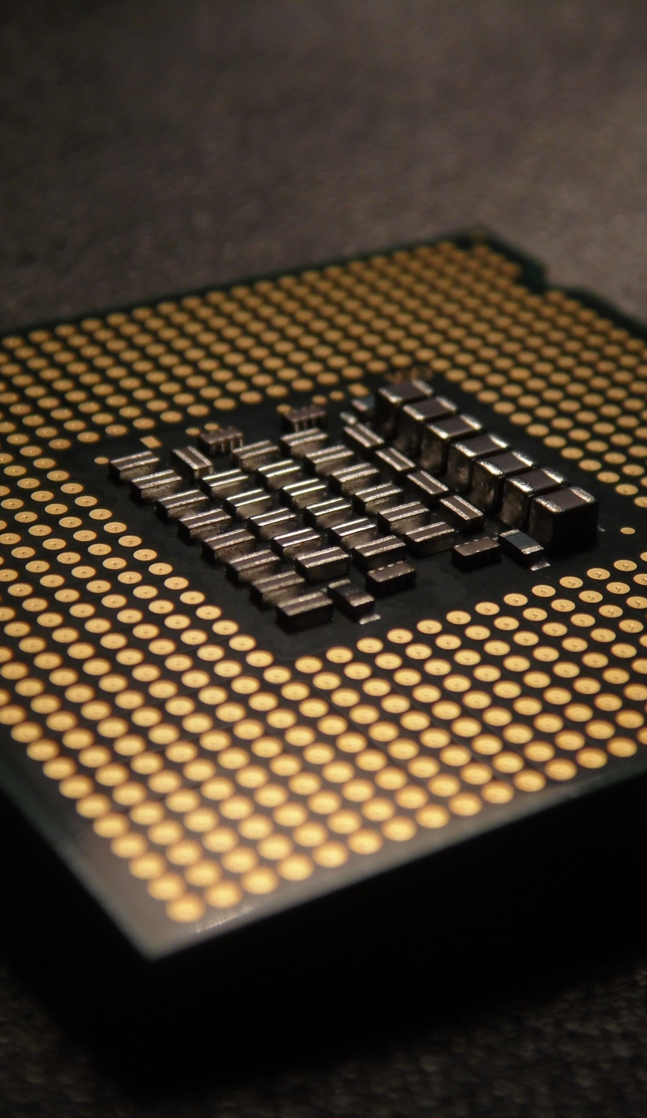
CS 4500: Operating Systems I
CPU Scheduling
Dr. Serena “Sully” Sullivan
UCCS – Computer Science Department
ssulliv7@uccs.edu

Slide 2

Lecture Resources
Andrew S. Tanenbaum, Modern Operating Systems, 4thd edition, 2014, Prentice Hall
Peter Jay Salzman, Michael Burian, Ori Pomerantz, Bob Mottram, Jim Huang. The Linux Kernel Module Programming Guide, 2022. https://sysprog21.github.io/lkmpg/

Slide 3
Basic Concepts
Maximum CPU utilization obtained with multiprogramming
CPU–I/O Burst Cycle – Process execution consists of a cycle of CPU execution and I/O wait
CPU burst distribution

Slide 4
CPU Scheduler
Selects from among the processes in memory that are ready to execute, and allocates the CPU to one of them
CPU scheduling decisions may take place when a process:
  Switches from running to waiting state
  Switches from running to ready state
  Switches from waiting to ready
  Terminates
Scheduling under 1 and 4 is non-preemptive
All other scheduling is preemptive – implications for data sharing between threads/processes

Slide 5
What is CPU Scheduling?
new
admit
exit
terminated
interrupt
The five-state process model
ready
running
Assume 1 CPU
I/O or event completion
scheduler dispatch
I/O or event wait
blocked
CPU scheduling
Selects from among the processes/threads that are ready to execute, and allocates the CPU to it
Notes:
This situation occurs whenever two or more processes or threads are simultaneously in the ready state. If only one CPU is available, a choice has to be made which process to run next.
Many of the same issues that apply to process scheduling also apply to thread scheduling, although some are different. Initially we will focus on scheduling issues that apply to both processes and threads.

Slide 6
Why CPU Scheduling?
In support of multiprogramming
  Uniprocessor systems (this lecture)
    Time-sharing processor
  Real-time systems (this lecture)
    Reliably guaranteeing deadlines
  Multiprocessor systems (next lecture)
    Efficiently distributing tasks
What does CPU schedule?
  Processes, threads
Notes:
Back in the old days of batch systems with input in the form of card images on a magnetic tape, the scheduling algorithm was simple: just run the next job on the tape. With multiprogramming systems, the scheduling algorithm became more complex because there were generally multiple users waiting for service.
CPU time is a scarce resource on these machines, a good scheduler can make a big difference in perceived performance and user satisfaction

Slide 7
Dispatcher
A special program which comes into play after the scheduler
Dispatcher module gives control of the CPU to the process selected by the scheduler; this involves:
  Switching context
  Switching to user mode
  Jumping to the proper location in the user program to restart that program
Dispatch latency – time it takes for the dispatcher to stop one process and start another running

Slide 8
Scheduling Criteria
CPU utilization – keep the CPU as busy as possible
Throughput – # of processes that complete their execution per time unit
Turnaround time – amount of time to execute a particular process
Waiting time – amount of time a process has been waiting in the ready queue
Response time – amount of time it takes from when a request was submitted until the first response is produced, not output (for time-sharing environment)

Slide 9
Scheduling Algorithm Optimization Criteria
Max CPU utilization
Max throughput
Min turnaround time
Min waiting time
Min response time

Slide 10

CPU Scheduling
Process context
  Minimal set of state info that must be stored to allow a process to be stopped and restarted later
  Information stored in CPU
    Contents of registers
      Program counter
  Information stored in RAM
    PCB
Notes:
a switch from user mode to kernel mode must occur. Then the state of the current process must be saved, including storing its registers in the process table so they can be reloaded later. In some systems, the memory map (e.g., memory reference bits in the page table) must be saved as well. Next a new process must be selected by running the scheduling algorithm

Slide 11
CPU Scheduling
CPU scheduling may take place at
  Clock interrupts
  I/O interrupts
  I/O completion
  Termination
Non-preemptive: Scheduling only when current process terminates or gives up control
Preemptive: Processes can be forced to give up control
preemptive
non-preemptive
ready queue
pick_next_task()
processor
exit/blocked
preemption
Notes:
The OS maintains all PCBs in Process Scheduling Queues. The OS maintains a separate queue for each of the process states and PCBs of all processes in the same execution state are placed in the same queue. When the state of a process is changed, its PCB is unlinked from its current queue and moved to its new state queue.
Ready queue − This queue keeps a set of all processes residing in main memory, ready and waiting to execute.

Slide 12
Scheduling Goals
User oriented → minimize
  Response time (wait time): the time that the first response is received (interactivity)
  Turnaround time: the time that the task finishes
  Unpredictability: variations in different runs
System oriented → maximize
  Throughput: # of tasks that finish per time unit
  Utilization: the percentage of time the CPU is busy
  Fairness: avoid starvation
Notes:
These services usually share two common features which can be used to identify if it is a cloud service. There are usually three layers in cloud computing. Companies use them differently based on what they offer. From the top to the bottom, we have application, platform and computer infrastructure as services. At the bottom is the foundation, the infrastructure. This is the layer where cloud hosting lives. In cloud hosting, traditional web or server applications run in virtual servers. Hosting in a cloud is an economical way for small companies to build their own web services since it removes the up-front commitment to hardware resources and only rent the necessary capacity from cloud. Its success depends on effective capacity management.

Slide 13
Scheduling Policies
  First-Come First -Served (FCFS)
  Shortest-Job-First (SJF)
  Round Robin (RR)

Slide 14
Scheduling Policies
Basic policies
  First-Come First -Served (FCFS)
  Shortest-Job-First (SJF)
  Round Robin (RR)
Implementation: pick the next ready task to run
  How we design pick_next_task()
Performance: response time and turnaround time
ready queue
pick_next_task() *
processor
exit/blocked
preemption
Notes:
http://www.tutorialspoint.com/operating_system/os_process_scheduling.htm

Slide 15

FIFO (aka FCFS) with Example

Slide 16
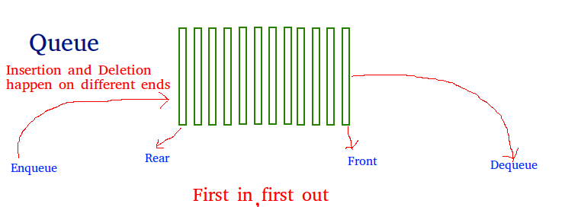
First-Come, First-Serve (FCFS)
Simplest CPU scheduling algorithm
Managed with a first in first out (FIFO) queue

Slide 17
First-Come, First-Serve (FCFS)
The new process is in line at the tail of the queue
Processes cannot skip forward or move backward in line
When a process enters the queue, the Process Control Block (PCB) is linked to the tail of the queue
Once the first process is complete it is removed from the queue and the next process in the queue can be executed

Slide 18
First-Come, First-Serve (FCFS)
Average waiting time for a process to execute is long

Slide 19
First-Come, First-Serve (FCFS)
These processes arrive at time 0 (zero)
Burst time indicates how long the process will take to complete
Process | Burst Time in ms
P1 | 32
P2 | 8
P3 | 5
P1
P2
P3
0
32
40
45
Notes:
P1 did not have to wait any amount of time because it arrived first
P2 had to wait 32 ms before it could use the CPU
P3 had to wait 40 ms before it could use the CPU

Slide 20
Calculate Timing
Turn around time = Completion Time – Arrival Time
Waiting time = Turnaround time – Burst time
Response Time = Time process begins – Arrival time

Slide 21
What is the average waiting time in the FCFS Example?
P1 = 0 ms
P2 = 32 ms
P3 = 40 ms
0 + 32+40/3 = 24 average wait time per process

Slide 22
Example: Process Arrive in Different Order
Process | Burst Time in ms
P2 | 8
P3 | 5
P1 | 32
P3
P2
P1
0
8
13
45
0 + 8+13/3 = 7 ms average wait time per process

Slide 23
Turnaround Time
Process | Burst Time in ms
P2 | 8
P3 | 5
P1 | 32
Arrival Time
Turnaround Time in ms
1
40– 1 = 39
2
45 – 2 = 43
0
32 – 0 = 32
P1
P2
P3
Turn around time = Completion Time – Arrival Time
0
32
40
45
Notes:
Turnaround time is the amount of time it takes for a process to complete after it has arrived at the scheduler to the time the process is complete (including wait time) – not the same as burst time which is the amount of time it takes to process

Slide 24
Waiting Time
Arrival Time
Waiting Time
Process | Burst Time in ms
P2 | 8
P3 | 5
P1 | 32
Turnaround
Time in ms
1
40– 1 = 39
39 – 8 = 31
2
45 – 2 = 43
43 – 5 = 38
0
32 – 0 = 32
32 – 32 = 0
P1
P2
P3
Waiting time = Turnaround time – Burst time
0
32
40
45
Notes:
Turnaround time is the amount of time it takes for a process to complete after it has arrived at the scheduler to the time the process is complete (including wait time) – not the same as burst time which is the amount of time it takes to process

Slide 25
First-Come, First-Serve (FCFS)
Examples demonstrated the average waiting time for process to be scheduled by the CPU vary depending upon the order in which they arrive
Once a process has taken the entire CPU it keeps it unless the CPU is released
  Can be accomplished by terminating or requesting I/O
Cannot be used by time-sharing systems that requires CPU usage at regular intervals of time

Slide 26
First-Come, First-Serve (FCFS)
Process Arrival Time Burst Time
P₁ 0 8
P₂ 1 4
P₃ 2 9
P₄ 3 5
  CPU schedules the task that arrived earliest, non-preemptive
Change arrival
time to P1:3, P2:2,
P3:1, P4:0
Burst time the same
P₁
P₂
P₃
P₄
0
8
12
21
26
Average turnaround time = ((8-0)+(12-1)+(21-2)+(26-3)) / 4 = 15.25
Average response time = (0+(8-1)+(12-2)+(21-3)) /4 = 8.75
P₄
P₃
P₂
P₁
0
5
14
18
26
Average turnaround time = ((5-0)+(14-1)+(18-2)+(26-3)) / 4 = 14.25
Average response time = (0+(5-1)+(14-2)+(18-3)) /4 = 7.75
Notes:
processes are assigned the CPU in the order they arrive. Basically, there is a single queue of ready processes.
As other jobs come in, they are put onto the end of the queue. When the running process blocks, the first process on the queue is run next. When a blocked process becomes ready, like a newly arrived job, it is put on the end of the queue.
The great strength of this algorithm is that it is easy to understand and equally easy to program. a single linked list keeps track of all ready processes. Picking a process to run just requires removing one from the front of the queue. Adding a new job or unblocked process just requires attaching it to the end of the queue.
Nonpreemptive – the currently running process must be complete before the next process can run
Response time – amount of time from when a request was submitted until the first response is produced.

Slide 27
Shortest Job First (SJF)

Slide 28
Shortest Job First (SJF) Scheduling
The SJF algorithm considers with each process the length of the next process’s burst
The next process with the least burst will go first
If two processes have the same length then FCFS will be used to determine which process goes first
Sometimes referred to as Shortest Next CPU Burst Algorithm

Slide 29
Shortest Job First (SJF) Scheduling
Can be preemptive or nonpreemptive
Nonpreemptive: the process using the CPU has the CPU resources until it terminates, then the next process can initiate
Preemptive: if one process is using the CPU, another process can take the CPU (preempt) the first process based on some conditions

Slide 30
Shortest Job First (SJF) Scheduling (Nonpreemptive)
Process ID | Burst Time in ms
P1 | 7
P2 | 9
P3 | 8
P4 | 4
0
4
11
19
28
P4
P1
P3
P2
Average waiting time 0+4+11+19= 34/4 = 8.5 ms
Notes:
No other processes can interrupt the current process once it is using the CPU.
Average waiting time 0+4+11+19= 34/4 = 8.5 ms
See slide 29

Slide 31
Shortest Job First (SJF) Scheduling (Preemptive)
Process ID | Arrival Time | Burst Time in ms
P1 | 0 | 9
P2 | 1 | 5
P3 | 2 | 10
P4 | 3 | 6
= 8
0
1
6
12
20
30
P1
P2
P4
P1
P3
Notes:
This is preemptive scheduling because based on a condition the next process could take over the CPU, regardless if there is already a process running on the CPU.
At arrival time 0, the only process in the queue was P1, so it goes first
At arrival time 1, P2 arrives in the queue and has less burst time than P1. P1 is preempted and removed from the CPU. P2 starts at 1 and it takes 5 bursts, ending on 6.
At arrival time 2, P3 arrives and the burst time is greater than the burst time for P2, so P2 is not preempted.
At arrival time 3, P4 arrives and compares itself to the CURRENT time P2 is in its process – P2 was at 3 ms into its process, so P2 was not preempted
P2 completes its process and have to decide which process is next --- NOTE: You have to consider the amount of time the first process was using the CPU before it was preempted. In this case, P1 was using the CPU for 1 ms before P2 arrived, the burst time only has 8 ms remaining
Now, P4 has the shortest burst time, so it goes next for 6 ms

Slide 32
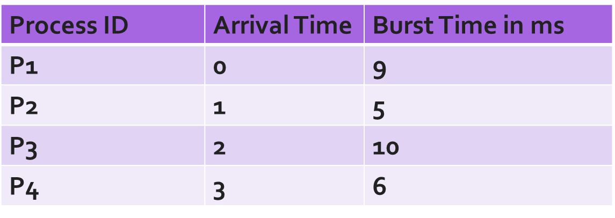
Calculate Average Waiting Time
Waiting time = total waiting time - # of ms process executed-arrival time
P1 waiting time = 12 – 1 – 0 = 11 ms
P2 waiting time = 1 – 0 – 1 = 0 ms
P3 waiting time = 20 – 0 – 2 = 18 ms
P4 waiting time = 6 – 0 – 3 = 3 ms
Avg waiting time = 11 + 0 + 18 + 3 = 32/4 = 8 ms
0
1
6
12
20
30
P1
P2
P4
P1
P3

Slide 33
Shortest Job First (SJF)
Process Arrival Time Burst Time
P₁ 0 8
P₂ 1 4
P₃ 2 9
P₄ 3 5
  CPU schedules the task with the shortest remaining time
non-preemptive
P₁
P₂
P₄
P₃
0
8
12
17
26
Average turnaround time = ((8-0)+(12-1)+(26-2)+(17-3)) / 4 = 14.25
Average response time = (0+(8-1)+(17-2)+(12-3)) /4 = 7.75
preemptive
P₁
P₂
P₄
P₁
P₃
0
1
5
10
17
26
Average turnaround time = ((17-0)+(5-1)+(10-3)+(26-2)) / 4 = 13
Average response time = (0+(1-1)+(5-3)+(17-2)) /4 = 4.25
Notes:
assumes the run times are known in advance. Shortest job first is provably optimal.

Slide 34
Disadvantages
Difficult to determine the burst of the next process
Optimal algorithm but is not great for short-term CPU scheduling
May be able to estimate the burst of the next process by assuming the next process has the same burst as the first process

Slide 35

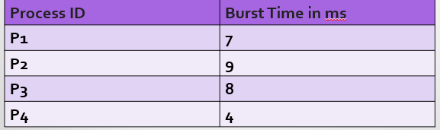
Question
How many milliseconds difference between SJB (nonpreemptive) and FCFS using the same table (assuming they arrive in order)?
Notes:
0+7+16+24=47/4=11.75 ms
11.75 – 8.5 = 3.25 ms

Slide 36

Round Robin

Slide 37
Round Robin Scheduling
Designed for time-sharing systems
Similar to FCFS but adds preemption
A time quantum or time slice is defined as a small measure of time 10 – 100 ms
Each process is assigned a time quantum
The process can use the CPU for the allotted time
Then the next process uses the CPU and so on for round one

Slide 38
Round Robin
CPU Running
1 time quantum
P1
1 time quantum
P2
1 time quantum
P3
1 time quantum
P4

Slide 39
Round Robin Scheduling
The queue is initially set up the same as FIFO
New processes added to the tail of the queue
CPU selects first process in line and sets the timer for one time quantum
Processes are selected until all the processes have had their turn with the CPU
Notes:
Time quantum can be between 10 ms – 100 ms

Slide 40
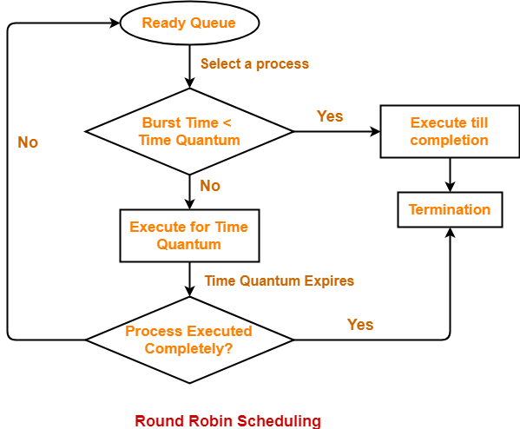
Round Robin
Image retrieved from : https://www.gatevidyalay.com/round-robin-round-robin-scheduling-examples/

Slide 41
Burst < time quantum
The process releases itself from the processor once complete
The CPU scheduler moves to next process

Slide 42
Burst > time quantum
The timer expires and the process is interrupted and a context switch places the process at the tail of the queue
The CPU scheduler then sees the next process in line

Slide 43
Turnaround, Waiting, and Response Times for Round Robin
Formulas:
Turnaround time = Completion Time – Arrival Time
Waiting time = Turnaround time – Burst Time
Response Time = Time process begins – Arrival time

Slide 44
Round Robin (RR)
Process Arrival Time Burst Time
P₁ 0 8
P₂ 1 4
P₃ 2 9
P₄ 3 5
  Like FCFS, but with limited time slices, preemptive
  Average Turnaround = Completion time – arrival time
  Average Response Time = Start time – arrival time
q=4
P₁
P₂
P₃
P₄
P₁
P₃
P₄
P₃
0
4
8
12
16
20
24
25
26
Average turnaround time = ((20-0)+(8-1)+(26-2)+(25-3)) / 4 = 18.25
Average response time = (0+(4-1)+(8-2)+(12-3)) /4 = 4.5
q=5
P₁
P₂
P₃
P₄
P₁
P₃
0
5
9
14
19
22
26
Average turnaround time = ((22-0)+(9-1)+(26-2)+(19-3)) / 4 = 17.5
Average response time = (0+(5-1)+(9-2)+(14-3)) /4 = 5.5
Notes:
Each process is assigned a time interval, called its quantum, during which it is allowed to run. If the process is still running at the end of the quantum, the CPU is preempted and given to another process. If the process has blocked or finished before the quantum has elapsed, the CPU switching is done when the process blocks
setting the quantum too short causes too many process switches and lowers the CPU efficiency, but setting it too long may cause poor response to short interactive requests. A quantum around 20–50 ms is often a reasonable compromise.

Slide 45
Turnaround and Waiting Times for Round Robin
All three processes arrive at the CPU scheduler at time 0. The time quantum is assigned as 4 ms
Process ID | Burst Time in ms
P1 | 23
P2 | 4
P3 | 3
0 4 8 11 15 19 23 27 30
P1
P2
P3
P1
P1
P1
P1
P1
Notes:
P3 voluntarily relinquishes the CPU after its burst time and the next process in line

Slide 46
Turnaround and Waiting Times for Round Robin
Process ID | Burst Time in ms
P1 | 23
P2 | 4
P3 | 3
0 4 8 11 15 19 23 27 30
P1
P2
P3
P1
P1
P1
P1
P1
Process ID | Completion Time | Turnaround Time | Waiting Time
P1 | 30
P2 | 8
P3 | 11
Notes:
Turnaround time = Completion Time – Arrival Time
Waiting time = Turnaround time – Burst time
Response Time = Time process begins – Arrival time

Slide 47

Priority Scheduling

Slide 48
Priority Scheduling: Preemptive or Nonpreemptive
Each process has a priority assigned and the highest priority uses the CPU first
If there are processes with the same priority, FCFS is used to determine which process goes first
Looking back to SJF
  Also a priority algorithm that bases priority on CPU burst times

Slide 49
Priority Scheduling: Preemptive
Preemptive priority scheduling will preempt the CPU if a process with a higher priority requests access to the resource

Slide 50
Priority Scheduling: Nonpreemptive
If a new process arrives and the current process is higher priority than the new process
  The process is placed at the head of the queue

Slide 51
Priority Scheduling
Process Priority Burst Time
P₁ 3 8
P₂ 1 4
P₃ 4 9
P₄ 2 5
  CPU schedules the highest priority first, FCFS within the same priority
P₂
P₄
P₁
P₃
Process Priority Burst Time
P₁ 2 8
P₂ 4 4
P₃ 1 9
P₄ 3 5
P₃
P₁
P₄
P₂
Notes:
Each process is assigned a priority, and the runnable process with the highest priority is allowed to run
Priorities can be assigned to processes statically or dynamically.
It is often convenient to group processes into priority classes and use priority scheduling among the classes but round-robin scheduling within each class.

Slide 52
Priority Scheduling: Waiting Time
Process ID | Arrival Time | Burst Time | Priority
P1 | 0 | 11 | 3
P2 | 0 | 2 | 1
P3 | 0 | 3 | 4
P4 | 0 | 2 | 5
P5 | 0 | 6 | 2
The smaller value for the priority goes first
Waiting Times:
P1 = 7
P2 = 0
P3 = 18
P4 = 21
0
2
8
19
22
24
P2
P5
P1
P3
P4
Average Waiting Time = 7 + 0 + 18 + 21/4 = 11.5 ms

Slide 53
Priority Scheduling Disadvantages
Low priority processes could wait indefinitely
Can cause indefinite waiting times resulting in starvation
Any process waiting that has lower priority may not ever have the opportunity to use the CPU

Slide 54
Solution to Priority Scheduling Disadvantages
Aging was introduced to overcome lower priority processes starving or being indefinitely blocked
Aging increases the priority of lower priority process over time
Notes:
Example:
Increase the priority over lower priority processes, perhaps increase the priority by one every 5 minutes. Eventually, a process with the initial value of 20 would eventually have the highest priority.

Slide 55
Put it together
 | Turnaround time | Response time
FCFS | 15.25 | 8.75
SJF-preemptive | 13 | 4.25
RR (q=5) | 17.5 | 5.5
 | Throughput | Response time | Starvation
FCFS | Depends | Depends | No
SJF-preemptive | High | Good | Yes
RR | Can be low | Good | No
Priority scheduling | Can be high | Can be good | Can remove
Multilevel Feedback Queue

Slide 56
Multi-level Queue Scheduling

Slide 57
Multi-level Queue Scheduling
A scheduling algorithm that classifies process into different groups
For example, processes could be divided into two categories: Foreground processes and Background processes
  The two groups have different response times and scheduling needs
  Foreground processes should take priority over background process

Slide 58
Multilevel Queue
Schedules groups of processes into several queues
Permanently assigned to one queue
Based on properties of the process like priority, process type, or memory size
Each queue uses a scheduling algorithm
Scheduling among the queues – fixed-priority preemptive scheduling
Notes:
For example, foreground process queue might be using the Round Robin algorithm and the background process queue might be using FCFS
Foreground queue could have absolute priority over background queue
If a background process is using the CPU and a foreground process requests access, the foreground process would preempt the background process

Slide 59
Multilevel Feedback Queue Scheduling
Notes:
https://youtu.be/1KLuC0knvs8

Slide 60
Multilevel Feedback Queue Scheduling
Like Multilevel Queue Scheduling, processes are grouped by similar characteristics, but in Multilevel Feedback Queue Scheduling processes are not permanently assigned queues, they can be moved to other queues
Divides processes by their CPU bursts

Slide 61
Multilevel Feedback Queue Scheduling
Processes that need more time using the CPU can be moved to lower-priority queue
Input, output, and interactive processes will be in the higher-priority queue
Can use aging - if the process needs to wait too long to use the CPU, it can be moved to a higher-priority queue,

Slide 62
Multilevel Feedback Queue
High priority/short task
RR, q=4
A task gradually moves up/down
RR, q=8
pick_next_task()
RR, q=16
Low priority/long task
Windows XP, Mac OS X, Linux 2.6.22 and before
Notes:
Processes in the highest class were run for one quantum. Processes in the next-highest class were run for two quanta. Processes in the next one were run for four quanta, etc. Whenever a process used up all the quanta allocated to it, it was moved down one class.
https://www.youtube.com/watch?v=1w9FybdNi_Y and https://youtu.be/kslttO1eX4I?t=34m11s if a thread blocks or yields before the quantum has been reached, it gets promoted; otherwise demoted
Let’s say in the highest priority queue a process is using RR and the burst for the process is higher than the quantum (ie, burst = 10, quantum = 4. Once the process has used its 4 ms and still has 6 ms to complete, it goes to the tail end of the second highest priority queue In this example, the process will complete in the second queue, but if it did not, it would move to the tail end of the next lowest priority queue

Slide 63
Parameters for Multilevel Feedback Queue
The number of queues
Which scheduling algorithm will be used for each queue
When to promote a process that is not being given resources by upgrading to a higher priority queue
Method used to demote a process to a lower priority queue
Determine which queue a process needs to moved to

Slide 64
Quick Self-Check of Learning

Slide 65
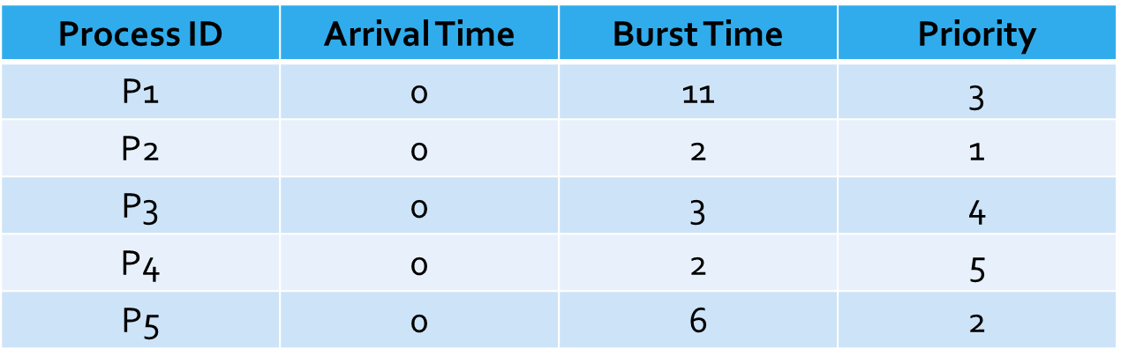
Question
Calculate the difference between the average waiting time for Round Robin and Priority Scheduling using the following chart
RR = 5 ms quanta and assume the processes arrive in order from P1 (first) to P5 (last)
Notes:
Answers on next two slides

Slide 66
Priority Scheduling: Waiting Time
Process ID | Arrival Time | Burst Time | Priority
P1 | 0 | 11 | 3
P2 | 0 | 2 | 1
P3 | 0 | 3 | 4
P4 | 0 | 2 | 5
P5 | 0 | 6 | 2
The smaller value for the priority goes first
Waiting Times:
P1 = 7
P2 = 0
P3 = 18
P4 = 21
0
2
8
19
22
24
P2
P5
P1
P3
P4
Average Waiting Time = 7 + 0 + 18 + 21/4 = 11.5 ms

Slide 67
Round Robin
RR = 5 ms quanta, assume the processes arrive in order
0
5
7
10
12
17
22
23
24
P1
P2
P3
P4
P5
P1
P5
P1
Notes:
Formulas:
Turnaround time = Completion Time – Arrival Time
Waiting time = Turnaround time – Burst Time
Response Time = Time process begins – Arrival time
Turnaround Time:
P1 = 24 – 0 = 24
P2: 7 – 0 = 7
P3: 10-0 = 10
P4: 12 – 0 = 12
P5: 23 – 0 = 23
Waiting Time:
P1: 24 – 11 = 13
P2: 7 – 2 = 5
P3: 10 – 3 = 7
P4: 12 – 2 = 10
P5: 23 – 6 = 17
Average Waiting Time: 13 + 5 + 7 + 10 + 17/5 = 10.4
Answer: 11.5 – 10.4
The difference between the two = 1.1

Slide 68
Linux Completely Fair Scheduler (CFS)

Slide 69
Completely Fair Scheduler
Default scheduler for Linux
Goal is to maximize CPU utilization and interactive performance
Not based on queues – based on red-black tree which uses timelines of future task execution
Uses nanosecond granularity accounting, the atomic units by which an individual process' share of the CPU was allocated – does not use time slices
Equally divides the time each process can use the CPU

Slide 70
Characteristics of a Red-Black Tree
1. Every node is assigned a color of red or black.
2. The root node is always black.
3. The children of a red node are black.
4. Every path from the root node to a leaf node contains the same number of black nodes.
Weiner, R. (2022) Generic Data Structures and Algorithms in Go. https://link.springer.com/content/pdf/10.1007/978-1-4842-8191-8.pdf
Notes:
Information for Red Black Trees found in Weiner, R. (2022) Generic Data Structures and Algorithms in Go. https://link.springer.com/content/pdf/10.1007/978-1-4842-8191-8.pdf

Slide 71
Red-Black Tree
The purpose of the red-black tree data structure is to attain insertion, deletion, and searching of items stored in the tree
Notes:
Information for Red Black Trees found in Weiner, R. (2022) Generic Data Structures and Algorithms in Go. https://link.springer.com/content/pdf/10.1007/978-1-4842-8191-8.pdf

Slide 72
Example: Insertion
Conduct an ordinary search-tree insertion.
The new node added is always red.
The goal is to keep all the nodes between the root and all nodes black.
What happens if a red node is inserted after an existing red node? The node will need to change color to red.
The image shows 25 was inserted red under 50, also red. Violates rule 3.
Notes:
Information for Red Black Trees found in Weiner, R. (2022) Generic Data Structures and Algorithms in Go. https://link.springer.com/content/pdf/10.1007/978-1-4842-8191-8.pdf

Slide 73
Insertion Example Cont.
We perform a correction by modifying the color of the parent (change red to black)
Change uncle red to black (150)
Change grandparent (100) if it is not the root (which it is in this case).
The corrected tree is shown in the following. If 100 was not the root, we might have to continue the search for violations up the tree after changing node 100 to red.
Notes:
Information for Red Black Trees found in Weiner, R. (2022) Generic Data Structures and Algorithms in Go. https://link.springer.com/content/pdf/10.1007/978-1-4842-8191-8.pdf

Slide 74
Insertion Example 2
Scenario: The parent of the node inserted is red and the uncle is black or does not exist.
View in order traversal of the subtree starting at the grandparent and label the nodes first, second, and third in the traversal; then the second node will always be the new root of the subtree and its left child the first and right child the third.
The traversal produces first = 25, second = 50, and third = 100.
After insertion, before changes
After changes
Notes:
Information for Red Black Trees found in Weiner, R. (2022) Generic Data Structures and Algorithms in Go. https://link.springer.com/content/pdf/10.1007/978-1-4842-8191-8.pdf

Slide 75
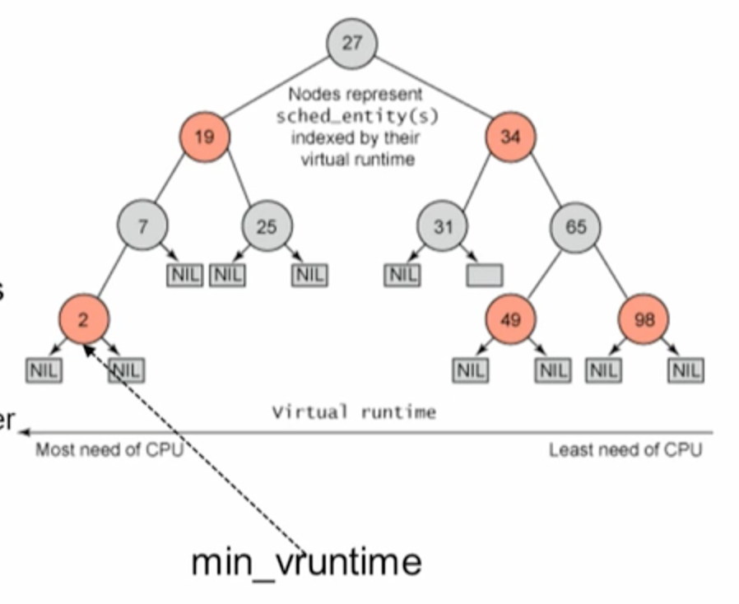
A Close Look at the State-of-Art
Linux Completely Fair Scheduler (CFS)
  Separate ready queue per processor
  Red-black tree based ready queue
  Proportional fair sharing
pick_next_task()
Remove leftmost task curr_leftmost;
Run the task;
vruntime + = runtime;
if vruntime > curr_leftmost’s
Preempt task;
Put it back to the sorted tree;
Remove curr_leftmost;
vruntime
Notes:
https://www.kernel.org/doc/Documentation/scheduler/sched-design-CFS.txt and http://www.ibm.com/developerworks/linux/library/l-completely-fair-scheduler/
https://www.youtube.com/watch?v=MkJfuI5_hjc RB tree https://www.youtube.com/watch?v=PhY56LpCtP4
it always tries to run the task with the smallest vruntime value (i.e., the task which executed least so far)
CFS picks the "leftmost" task from tree and runs it. As the system progresses forwards, the executed tasks are put into the tree more and more to the right --- slowly but surely giving a chance for every task to become the "leftmost task" and thus get on the CPU within a deterministic amount of time.

Slide 76
Summarizing RB Tree
CFS runs a task a bit
When the task schedules (or a scheduler tick happens) the task's CPU usage is "accounted for“
The (small) time it just spent using the physical CPU is added to p->se.vruntime.
Once p->se.vruntime gets high enough so that another task becomes the "leftmost task" of the time-ordered rbtree
It maintains (plus a small amount of "granularity" distance relative to the leftmost task so that we do not over- schedule tasks and trash the cache)
5. Then the new leftmost task is picked and the current task is preempted.
https://www.kernel.org/doc/Documentation/scheduler/sched-design-CFS.txt

Slide 77
Real-Time Scheduling

Slide 78
Real-Time Systems
Accuracy depends on timing and functionality
Traditional scheduling algorithms consider turn-around time (or throughput), fairness, and response time
Real-time systems are characterized by different metrics:
Timeliness : The measure of how closely it meet timing requirements
Predictability: The measure of how much deviation is in delivered timeliness

Slide 79
Real-Time Systems
Characterized by:
Timeliness (last slide)
Predictability (last slide)
Feasibility - Is it possible to meet the requirements for a particular task set?
Hard real-time - Specified tasks be run at specified intervals
  Failure to meet run the tasks could result in system failure
Soft real-time - Timely running of specified tasks desirable
  Failure to meet the requirements are degraded performance or recoverable failures.

Slide 80
Real-Time Scheduling
Real-time scheduling is more critical and difficult than traditional time-sharing in many ways
Some advantages:
Potentially determine how long each task will take to run
Starvation (of low priority tasks) may be acceptable
  Understanding the criticality of tasks allows the freedom to intelligently shed less critical work in times of high demand.
The work-load may be relatively fixed
  If the incoming traffic rate is relatively constant, it is possible to simultaneously achieve high utilization and good response time
Notes:
Baruah, S. Bertogna, M., Buttazzo, G. (2015). Multiprocessor Scheduling for Real-Time Systems. Springer. Located in the Springer database in the UCCS online library.

Slide 81
Real-time Scheduling
Schedulable real-time system
Given
  m periodic events
  event i occurs within period P_{i} seconds and requires C_{i} seconds
Then the load can only be handled (schedulable) if
Example: a real-time system with three periodic events, with periods of 100, 200, and 500 ms, respectively. If these events require 50, 30, and 100 ms of CPU time per event, respectively, the system is schedulable
  Process/context switching overhead is often an issue though!
  Given the example, what would be the maximum CPU burst for a 4th job with a period of 500 ms?
Notes:
having the right answer but having it too late is often just as bad as not having it at all
Depending on how much time each event requires for processing, handling all of them may not even be possible. A process that fails to meet this test cannot be scheduled because the total amount of CPU time the processes want collectively is more than the CPU can deliver.
X<= 75

Slide 82
Multiprocessor
A CPU contains many parts within it
  One or more memory caches for instructions and data
  Instruction decoders, and various types of execution units for ALU operations
A multiprocessor system contains more than one CPU
  Allows CPUs to work in parallel
  Known as Symmetric Multiprocessing
Notes:
http://superuser.com/questions/214331/what-is-the-difference-between-multicore-and-multiprocessor

Slide 83
Simultaneous Multithreading
Smaller subset of a processor's or core's components is duplicated
SMT core could have duplicate thread scheduling resources
  The core appears as two separate processors to the OS
  Despite one set of execution units.
Example: Intel's Hyperthreading.
Notes:
http://superuser.com/questions/214331/what-is-the-difference-between-multicore-and-multiprocessor

Slide 84
Challenges on Emerging Hardware and Applications
ready queue
pick_next_task()
processor
Multiprocessor = more powerful processor
…
pick_next_task() will be the bottleneck
Linux 2.4.x
Multiprocessor → Many core
processor
ready queue
pick_next_task()
processor
…
…
Load balancing
Cache affinity
Problem:
Self-scheduling, global control is difficult
Linux 2.6.x
ready queue
pick_next_task()
processor
Notes:
http://superuser.com/questions/214331/what-is-the-difference-between-multicore-and-multiprocessor
When we have a fixed number of processes, the cache content is relatively consistent.

Slide 85
Summary

Slide 86
Summary
The basic scheduling policies are important
  Multilevel Feedback Queue = RR + Priority
  CFS = RR + SJF + Priority + smart data structure
Additional readings
  Go to http://lxr.linux.no/linux+v2.6.24/kernel/
  Read /kernel/sched.c, /kernel/sched_fair.c, /include/linux/sched.h (starting from the schedule(void) function)
  See how the vruntime is actually updated
  Documentation: http://www.kernel.org/doc/Documentation/scheduler/sched-design-CFS.txt
  Another interesting scheduler: BFS
    http://ck.kolivas.org/patches/bfs/bfs-faq.txt
Notes:
BFS is the Brain Fuck Scheduler

Slide 87
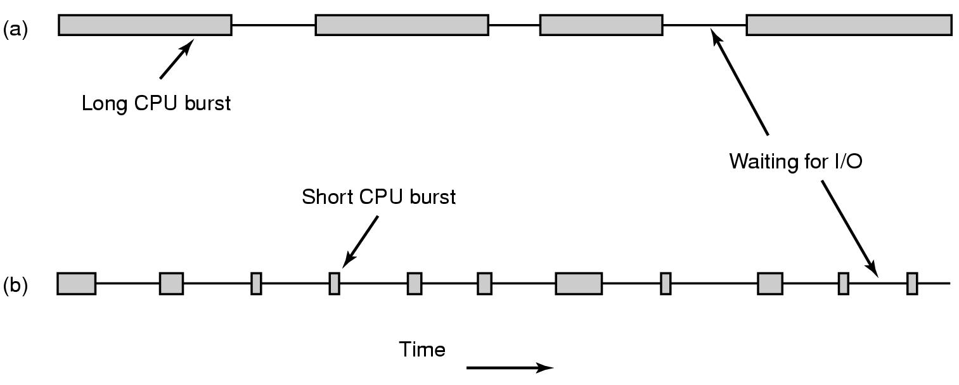
Process Behaviors
Bursts of CPU usage alternate with periods of I/O wait
  a CPU-bound/CPU-intensive process
  an I/O bound/I/O intensive process
    I/O is when a process enters the blocked state waiting for an external device to complete its work
Notes:
Nearly all processes alternate bursts of computing with (disk or network) I/O requests: a process enters the blocked state waiting for an external device to complete its work
Compute-bound processes typically have long CPU bursts and thus infrequent I/O waits, whereas I/O-bound processes have short CPU bursts and thus frequent I/O waits. Note that the key factor is the length of the CPU burst, not the length of the I/O burst. I/O-bound processes are I/O bound because they do not compute much between I/O requests, not because they have especially long I/O requests.

Slide 88

Scheduling
Policies
Batch Systems
  First-Come First-Serve
  Shortest Job First
  Shortest Remaining Time Next
Interactive Systems
  Round-Robin
  Priority Scheduling
  Multiple Queues
  Shortest Process Next
  Guaranteed Scheduling
  Lottery Scheduling
Real-time Systems
  Rate Monotonic Scheduling
  Earliest Deadline First Scheduling
This Photo by Unknown Author is licensed under CC BY-NC

Slide 89
For Next Time
Read: Andrew S. Tanenbaum, Modern Operating Systems, 4thd edition, 2014, Prentice Hall Chapter 2
Start Project 1 if you have not begun yet
Continue to complete homework 1

